Slide 1
Academic Writing: Avoiding Plagiarism
Citations, References and Sources

Slide 2
Referencing
Every piece of research, theory, facts that you talk about within your work that is not your own creation must have details of where you got it. There are two parts, the Citation and the Reference
If you have read tonnes of books but haven’t used some of them in your writing (though they may have influenced your opinions) you can add these to a Bibliography – many assignments do not require a Bibliography but adding it will not lose any marks.

Slide 3
Why Reference?
It helps reduce the possibility of committing plagiarism, in that you will have declared all your sources.
More positively, it allows you to indicate the breadth of your secondary reading; to show your awareness of material relevant to the topic.
It removes the bibliographical ‘clutter’ from the body of your essay, allowing your ideas to stand out clearly.

Slide 4
What is Plagiarism?
‘Plagiarism’ literally means ‘kidnapping’ or ‘theft’. It is simply taking the words/illustrations of OTHERS and passing them off as your own. It is taking other people’s or organisation’s ideas (what is known as ‘intellectualproperty’) and presenting in your report as your own.

Slide 5
Report structure:
Reports contain sections rather than one continuous text
Reports are structured in a uniform way and contain numbered headings
Reports may contain additional information such as:
Title
Contents page
Abstract/summary (when required)
Introduction
Body of report (sectioned with headings)
Conclusions
Recommendations (when required)
Reference

Slide 6
How to avoid it
It can easily be avoided, though: simply by giving the author a name-check. Normally, this will be done in one of two ways.
Paraphrasing
Quoting

Slide 7
Paraphrasing
Taking another person’s ideas and putting them in your own words
As Peter Singer (1990, p. 198) notes, a different conchumanism. But it was, as its very name suggests, still centred on ‘humans’ – not on a tendency to be ‘humane’

Slide 8
Quoting
Putting the authors words in quotation marks and using them without modification
Of course, ‘humanism ... has nothing to do with humanitarianism, the tendency to act humanely’ (Singer, 1990, p. 198).

Slide 9
Correct Citation
The citation can be placed in several locations in the sentence:
at the beginning:
Porter’s (1985) value chain model examines….
in the middle:
central to service quality (Gabbott and Hogg, 1998), even though…..
at the end:
...weaknesses in the service (Bateson and Hoffman, 1999).

Slide 10
Secondary Sources
For example another author quoted in a book is called a secondary source
Secondary sources: you may refer to an author’s work which is included in a book or journal written by another author. You need to include both authors in the text citation. You should also include the relevant page number.
(Harry, 2001 cited in Hannagan, 2008, p. 518)

Slide 11
Reference Page
Alphabetical order by last name
Book
Author. (Year) Title. Edition. Place of publication: Publisher.
Edited book
Editor. (ed/s.) (Year) Title. Edition . Place of publication: Publisher

Slide 12
Reference Page
Magazine article
Author. (Year) Title. Magazine, Date, Volume , Issue number, pp. Pages.
Newspaper article
Reporter. (Year) Title. Newspaper, Date, pp. Pages.
Webpage
Author or Organisation. (Year) Title [Online]. Available from: <URL> [Accessed Date]

Slide 13
Primary Vs Secondary Sources
Primary sources are original materials. They are from the time period involved and have not been filtered through interpretation or evaluation. Primary sources are original materials on which other research is based. They are usually the first formal appearance of results in physical, print or electronic format. They present original thinking, report a discovery, or share new information.

Slide 14
Primary Vs Secondary Sources
Secondary sources are less easily defined than primary sources. Generally, they are accounts written after the fact with the benefit of hindsight. They are interpretations and evaluations of primary sources. Secondary sources are not evidence, but rather commentary on and discussion of evidence.

Slide 15
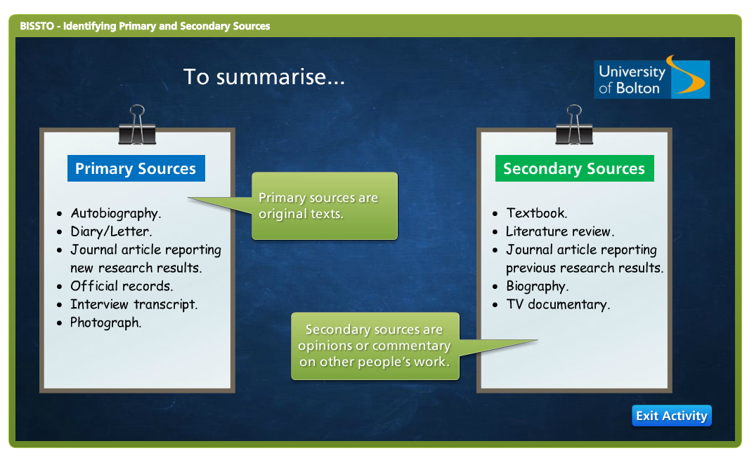

Slide 16
Group Activity
Now pickup exercise 1 and give it a go.
Best advice: practice and make it natural

